Slide 1









NOTICE: Proprietary and Confidential This material is proprietary to Geocent. It contains trade secrets and confidential information which is solely the property of Geocent. This material is solely for the Client’s internal use. This material shall not be used, reproduced, copied, disclosed, transmitted, in whole or in part, without the express consent of Geocent. © 2009 All rights reserved
Centered on Solutions
Sprint Artifact
GSA 18F BPA Agile RFQ
Sprint 0 Review
June 18, 2015

Slide 2
Agenda
Sprint 0 Goal
Accomplishments
Action Items
Process for Acceptance
Definition of Done
List of Technologies
Architectural Diagram
Sprint 0 Stories
Sprint 0 Burndown Chart
Sprint Schedule

Slide 3
Sprint 0: Capture Sprint
Goals:
Create Vision Document
Identify Epics, Stories
Establish Infrastructure
Choose Technical Approach
Create Architectural Diagram
set up virtual architecture design meeting
Create Table of Technologies
list benefit for each and how they will be used
Establish Testing Plan
identify technology for code testing, identify user testing pool
Identify Name of Product
Create CI/CM document

Slide 4
Sprint 0: Capture Sprint
Accomplishments:
Reviewed Architecture diagram, discussed adjustments
Discussed Technologies for CI
Ensure security through branch strategy, after code review and before check in to master
PMP and QA process documented, in final review – Jared
Action Item:
Need to apply for API keys

Slide 5
Sprint 0: Capture Sprint - Discussion
Process for Acceptance
Angular, Protractor for Unit Test, End-to-End Test, and Jazz Syntax
Jenkins for Unit Test and CI build, Integration Test (End-to-End) once deployed
Unit Test completed by Dev
Check in to branch
Pull request (QA) review – check in to approve
Before close out merge into master
Protractor Test
Wrap Jenkins with job if fails, output to Junit to determine results (Gult)
Automatic check in to branch – look at master and pull request to review before goes into master
Set Jenkins feature branch into pipeline for Integration Test
Definition of Done
Unit Test on Dev level
Unit Test Jenkins
CI Build
Integration Test
Merge to Master

Slide 6
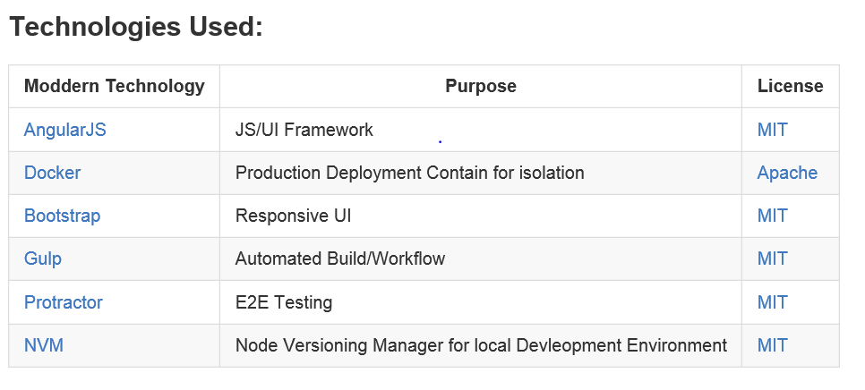
Sprint 0: Technologies

Slide 7
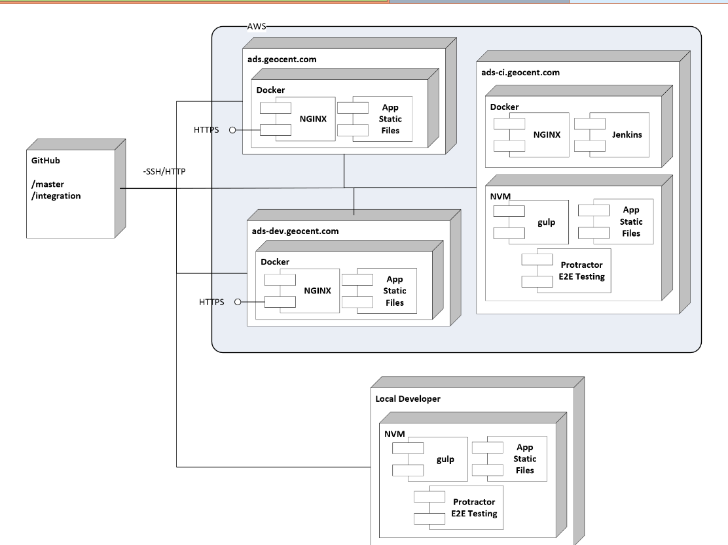
Sprint 0: Architectural Diagram

Slide 8
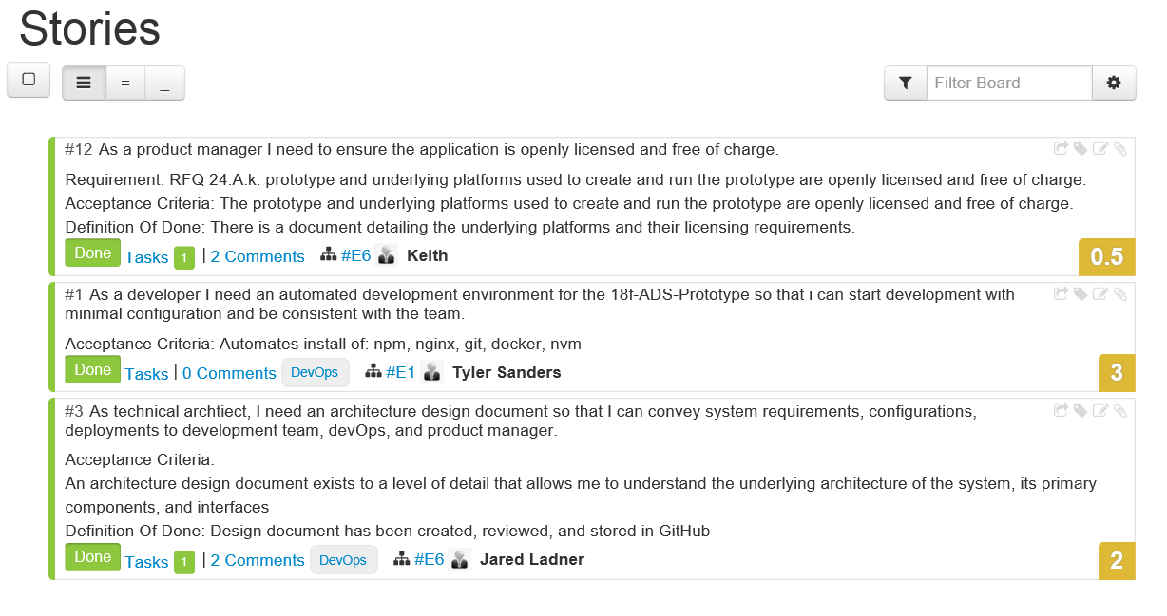
Sprint 0: Stories

Slide 9
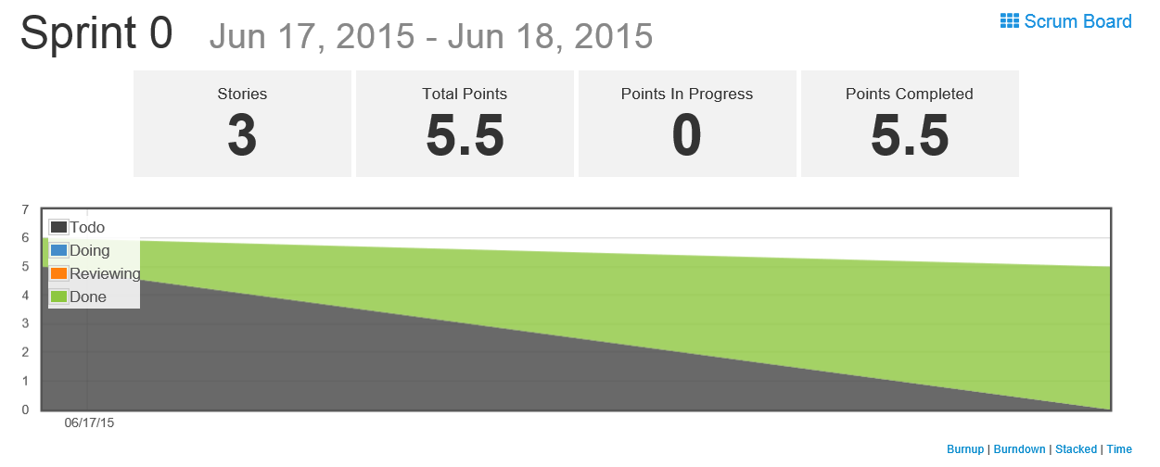
Sprint 0: Burndown Chart

Slide 10
Sprint Schedule
Sprint 0 – Capture Sprint
6/17/2015
Sprint 0 Planning: 6/17
Sprint 0 Review: 6/18
Sprint 1 – Architecture, Development, Testing
6/18/2015 – 6/22/2015
Sprint 1 Planning: 6/18
Sprint 1 Review: 6/23
Sprint 2 – Finalize Product, Final QA Testing, User Testing
6/23/2015 – 6/24/2015
Sprint 2 Planning: 6/23
Sprint 2 Review: 6/25
Sprint 3 – Stabilization Sprint
6/25/2015
Deliver
6/26/2015
Completed

Slide 11

Questions

Slide 12


